Slide 1
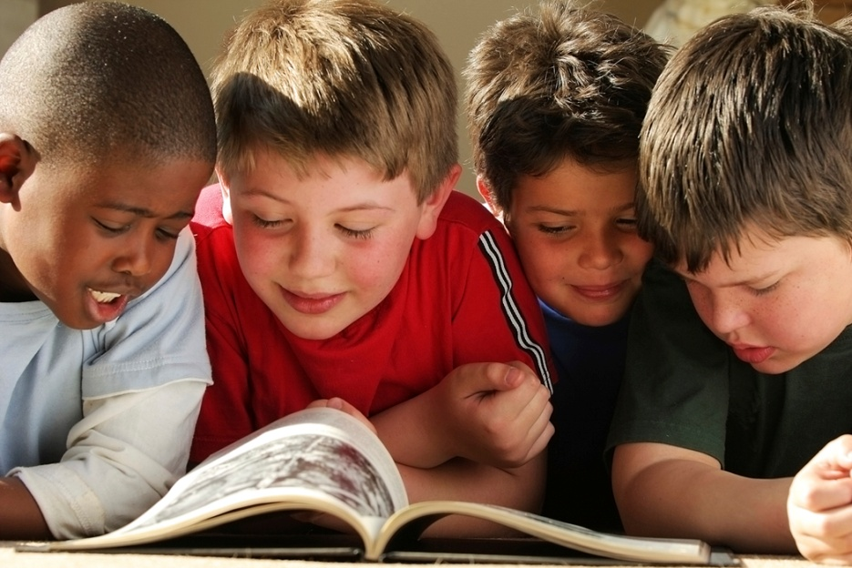
Once you learn to read, you will be forever free.”
^{- Frederick Douglass}

Slide 2
Did you read an email this morning?
a text message?
a street sign?
a newspaper? magazine? book?
A cereal box?

Slide 3
Literacy
Rotary International Commitment
Autoskill Program
Woodland Needs
Dingle School Success
Going Forward
What You Can Do

Slide 4
Rotary International Commitment
RI President John Kenny’s focus to the district governors in January, 2009:
If Rotary is to stay relevant in the 21st century, it must work to improve access to clean water, combat hunger, and expand literacy.

Slide 5

Rotary International Commitment
Cooperative relationships with
  International Reading Association
  Imagination Library/Dollywood Foundation
  Autoskill : Computer Assisted Literacy Solution (CALS)

Slide 6
Autoskill Program
Online/computer assisted literacy solution
Rotary International arrangement
  Company validated
  special pricing
Academy of Reading
  A phonics based reading course
Academy of Math

Slide 7
Autoskill Program
Children are selected
A facilitator and location are selected
Software is loaded to computers with internet
Children participate for ½- 1 hr per day
The program takes each child through exercises, tests and rewards at individual pace

Slide 8
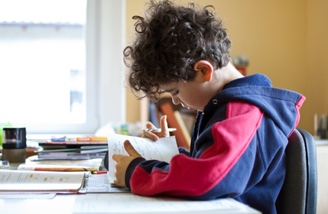
Autoskill Program
Typical child increase reading ability at least 1 level, some as many as 3 levels
All within 6 months
Academy of Math is used as a reward – kids love it and improve in math as well as reading

Slide 9
Autoskill Program
Cost: $240 per child
  Autoskill pays $80
  Rotary International pays $80
  Local funds $80
Can you afford $80 to help a child read?

Slide 10
Woodland’s Needs
1.6 million children – 25% of the state’s public school students are English learners
300,000 more than 10 years ago
85% are U.S. citizens by birth
Although Spanish is the most common language, California’s English learners speak more than 50 different languages

Slide 11
Woodland’s Needs
Woodland Joint Unified English Learners
English Learners
2008 3,416 32.0%
2000 2,581 24.9%
1996 2,005 22.3%

Slide 12
Woodland’s Needs
Beamer 210 52.7%
Dingle 164 38.5%
Freeman 202 42.8%
Gibson 147 23.3%
Grafton 92 67.6%
Plainfield 58 18.3%
Ramon S. Tafoya 361 40.7%
Rhoda Maxwell 202 40.8%
T.L.Whitehead 186 47.0%
Willow Spring 142 22.6%
Woodland Prairie 422 61.3%

Slide 13
Dingle School’s Success
25 3rd graders selected – English learners
Luna Vista Club donated $1,200
Principal Chaidez obtained $800 grant
An after school program
Used school’s computer lab
Teachers volunteered their time as facilitators

Slide 14
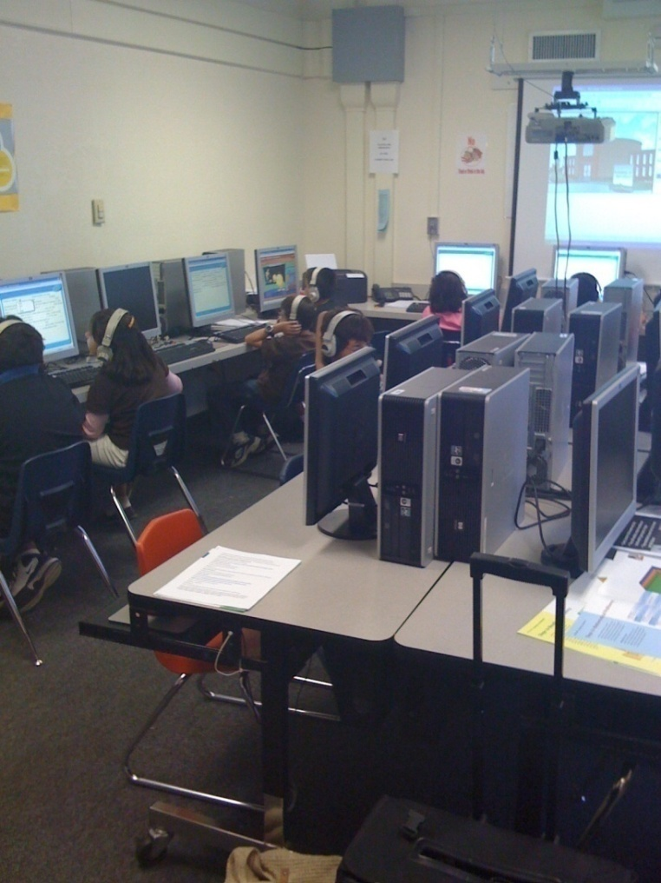
Dingle School’s Success
Reading Performance Level Summary Pre-test October 29, 2008
4 % Advanced ( 1 student )
20 % Proficient ( 5 students )
8 % Basic ( 2 students )
68 % Below Basic ( 17 students )

Slide 15
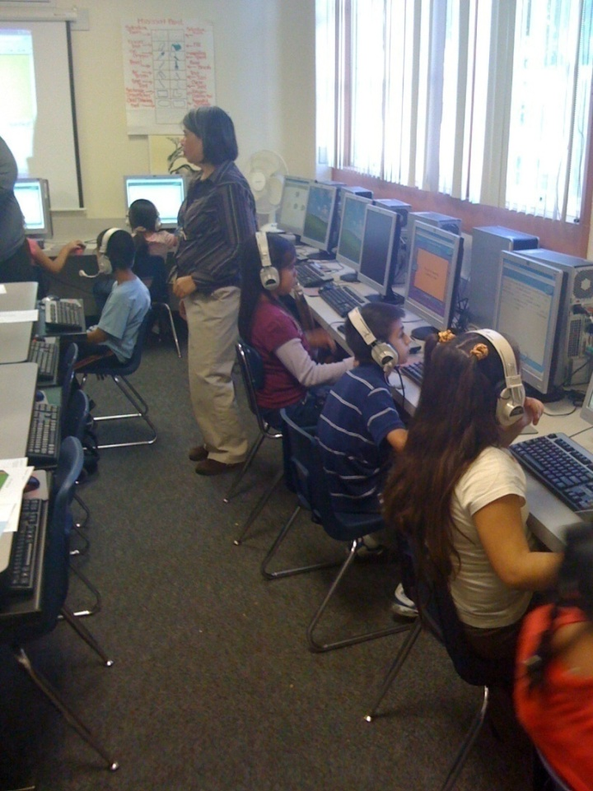
Dingle School’s Success
Reading Performance level summary Post-test March 11,2009
8 % Advanced ( 2 students )
48 % Proficient ( 12 students )
20 % Basic ( 5 students )
24 % Below Basic ( 6 students )

Slide 16

Going Forward
Luna Vista is sponsoring children at Dingle School this year
  – projected 25 3rd graders
We are looking for partners to expand the number of children at Dingle and possibly include another school

Slide 17
What You Can Do
Join Luna Vista Club to expand the program
  Fund additional children at Dingle School
  Sponsor another school
Individually sponsor a child at Dingle School
Participate in Dollywood Foundation program
Partner with International Reading Association
Lead a book donation project

Slide 18
What You Can Do
Celebrate International Literacy Day -September 8
Celebrate Literacy Month – March
Enjoy reading a book!

Slide 19
Carolyn Schrader
Mid Valley Area Literacy Team Leader
530.405.6089
carolynschrader@energychangesolutions.com

Slide 20

Change a child’s life
for only
$80

